Slide 1


Spreadsheet software
Advanced features

Slide 2
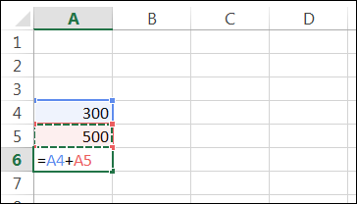
Cell references
When writing a formula there are advantages in writing the cell reference into the formula rather than the value in each cell.
=A4+A5 rather than =300+500
Discuss the advantages of using cell references.

Slide 3
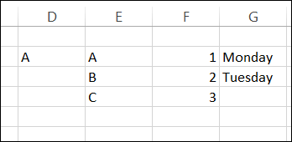
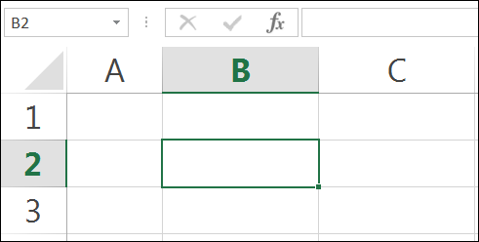
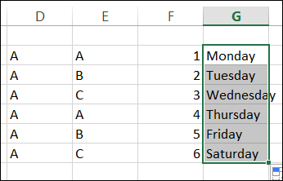
Fill handle
The fill handle is a small black square on the bottom right-hand corner of the active cell.
The fill handle allows the content of one cell to be copied into other cells.
It can also be used to extend a series of numbers or dates to other cells on the worksheet.

Slide 4
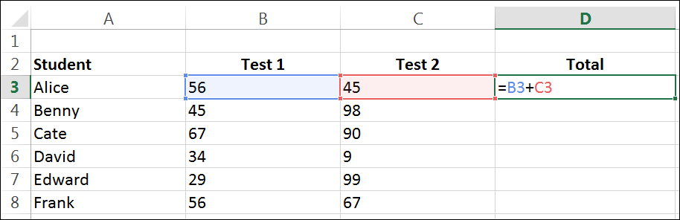
Fill handle – copying formulas
The fill handle can also be used to copy formulas from one cell to another.
In the example above Total = Test 1 + Test 2
So for Alice the Total in cell D3 will be B3+C3, for Benny Total will equal B4+C4, for Cate it will equal B5+C5, etc.
The fill handle can be used to copy the formula into the other cells in the Total column.

Slide 5
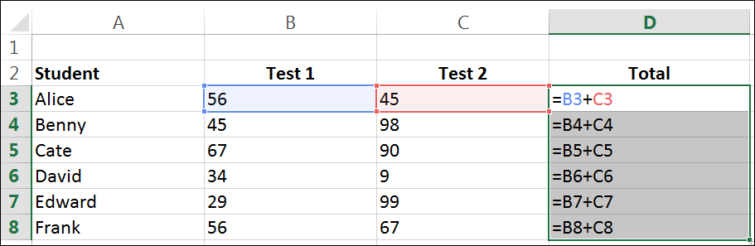
Fill handle – copying formulas
When using the fill handle to copy a formula, the cell references in the formula will change slightly.
The change in the cell reference will depend on if the cell was copied across columns or down rows.
In this example the formula is being copied down rows. As the formula is copied down the row number in each formula changes.
This keeps the calculation correct of each Student’s Total.

Slide 6
Relative cell referencing
This is an example of a relative cell reference.
Relative cell references are cell references that change when a formula is copied using the fill handle.
The column letter or row number of the formula changes relative* to the location of the original cell.
By default all cell references in spreadsheet software are relative.
* Find the meaning of the word relative.

Slide 7
Absolute cell referencing
In the example below we wanted the cell references for both Test 1 and Test 2 to change relatively as the formula was copied using the fill handle.
e.g. B3 and C3 to change to B4 AND C4.
But there maybe times where you may not want the formula to change when copied.

Slide 8
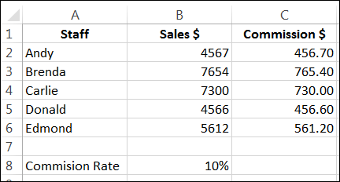
Absolute cell referencing
Falcon Fashions
Staff at Falcon Fashions receive 10% commission for every dollar of sales made.
The spreadsheet below is used to calculate commission $.

Slide 9
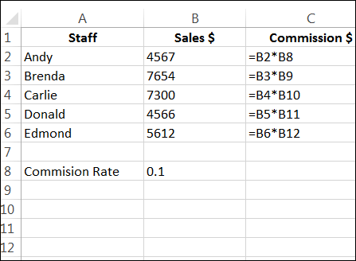
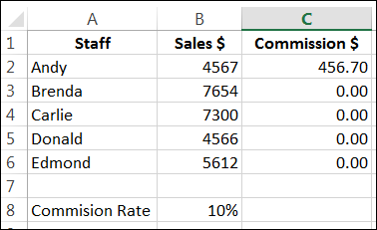
Absolute cell referencing
Falcon Fashions
The formula for Commission $ in cell C2 is =B2*C8.
But when this formula is copied using the fill handle errors occur.
Why are errors occurring?

Slide 10
Absolute cell referencing
Falcon Fashions
Errors are occurring because the cell reference for commission rate is changing.
But this cell reference needs to stay the same (B8) when the formula is copied.
This can be achieved by using absolute cell referencing.

Slide 11
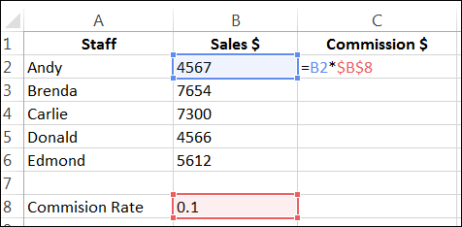
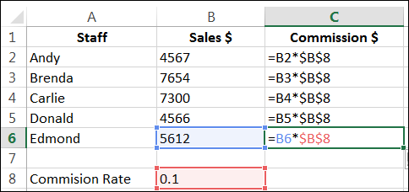
Absolute cell referencing
Absolute cell references are cell references that do not change when a formula is copied using the fill handle.
To make a cell reference absolute we added dollar signs ($) to the cell reference in the formula.
In this situation, we need cell B8 to be absolute while cell B2 is to be relative.
Why?

Slide 12
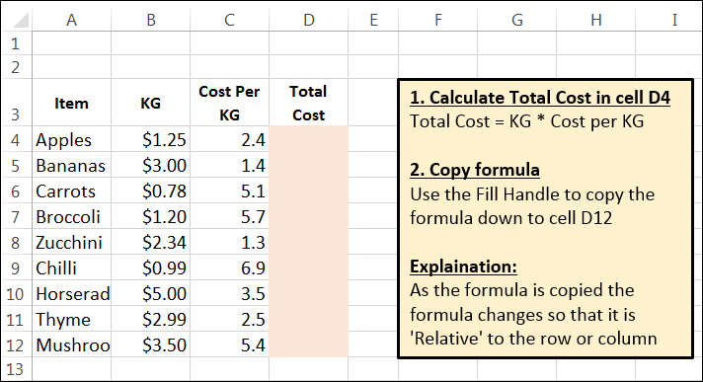
Activity: absolute and relative cell referencing
Download the absolute and relative workbook from elearn.
Complete all the tasks on the three worksheets.
Think
Think of the advantages of using the fill handle when building a spreadsheet.
Pair
Discuss the advantages with the students around you.
Share
Report your group's advantages to the class.

Slide 13
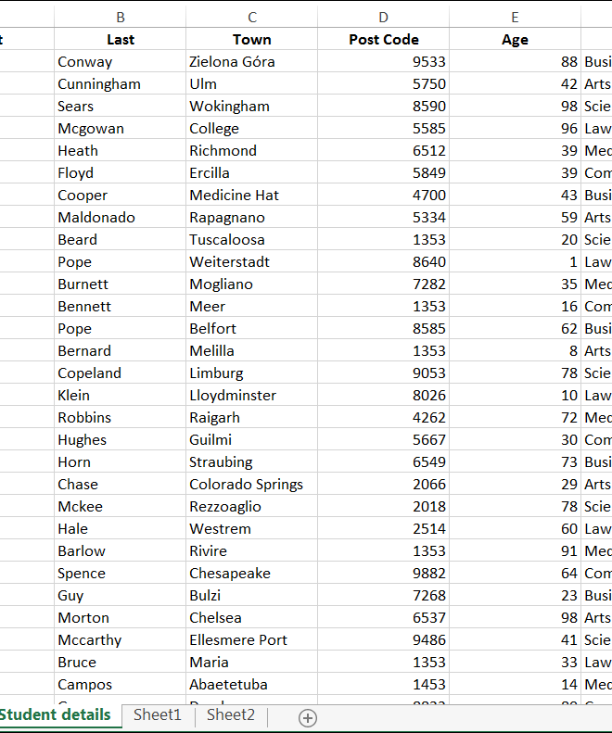
Sorting data
A useful feature of spreadsheet software is the sort feature.
Data can be sorted into alphabetical or numerical order by any column.
There are a number of ways data can be sorted.
Data within one column can be sorted
Data within multiple columns can be sorted based upon the values of one column
The Sort icon can be found on the Data menu.

Slide 14
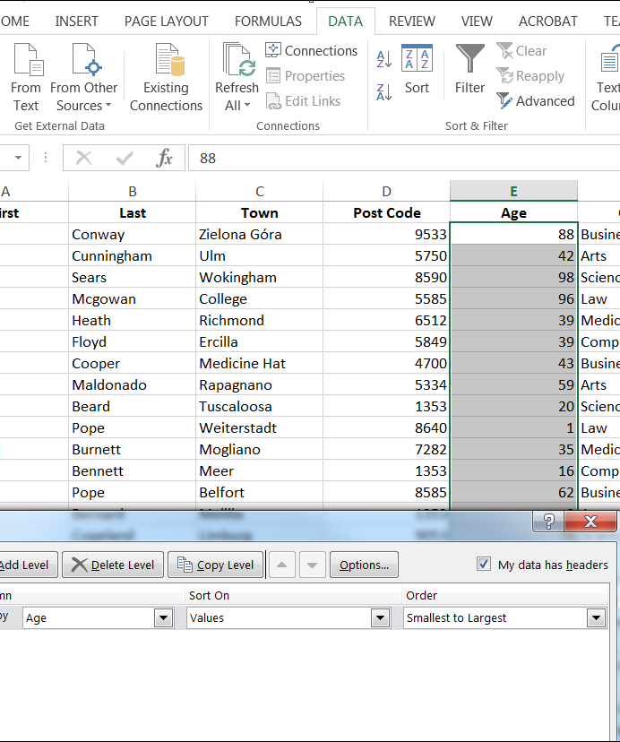
Sorting data
Let’s sort the Age column only.
Select the column to be sorted
Select Data > Sort
Sort by Age > Values > Smallest to Largest
Click OK

Slide 15
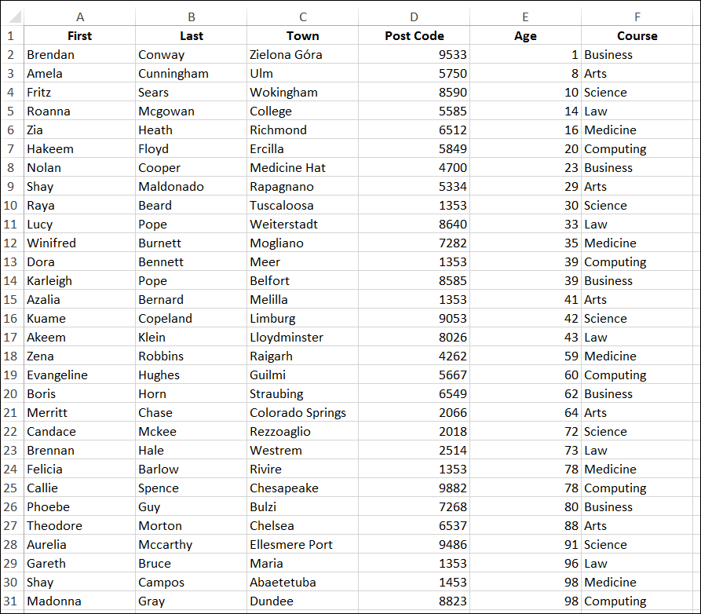
Sorting data
Let’s sort the Age column only.
Select the column to be sorted
Select Data > Sort
Sort by Age > Values > Smallest to Largest
Click OK
The data in the Age column is now sorted.
Problem
The Age in each row no longer matches the other data in the same row.
e.g. Brendan Conway is not 1.

Slide 16
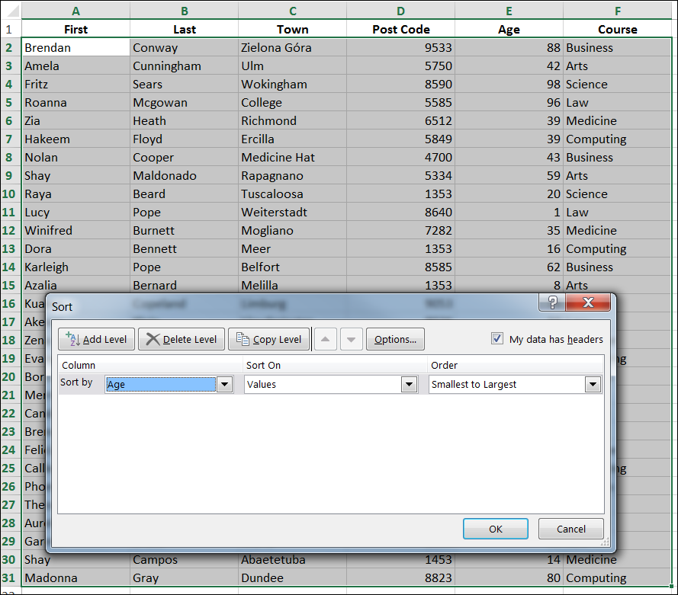
Sorting data
Let’s sort all of the columns by the value in the Age column.
Select all of the columns
Select Data > Sort
Sort by Age > Values > Smallest to Largest
Click OK

Slide 17
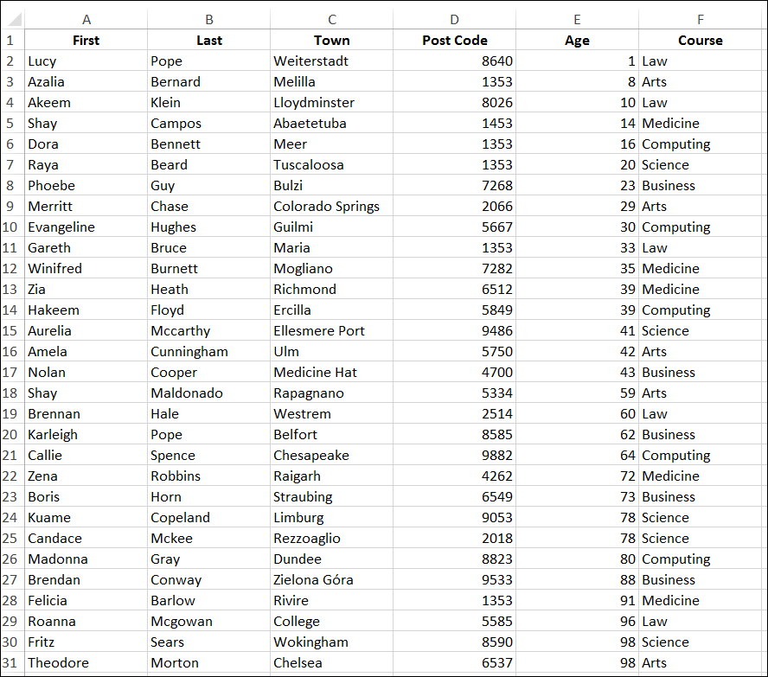
Sorting data
Let’s sort all of the columns by the value in the Age column.
Select all of the columns
Select Data > Sort
Sort by Age > Values > Smallest to Largest
Click OK
Now the data in every column is sorted based upon the Age.
But each row of related data is still kept together.
e.g. Lucy Pope is 1.

Slide 18
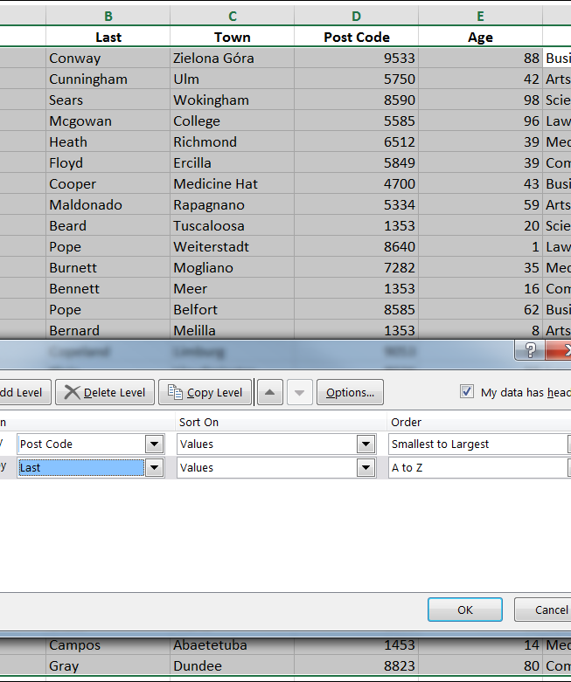
Sorting data
Let’s now sort the data by two columns – Post Code and Last (name).
Select all of the columns
Select Data > Sort
Sort by Post Code > Values > Smallest to Largest
Click Add Level
Sort by Last > Values > A to Z
Click OK

Slide 19
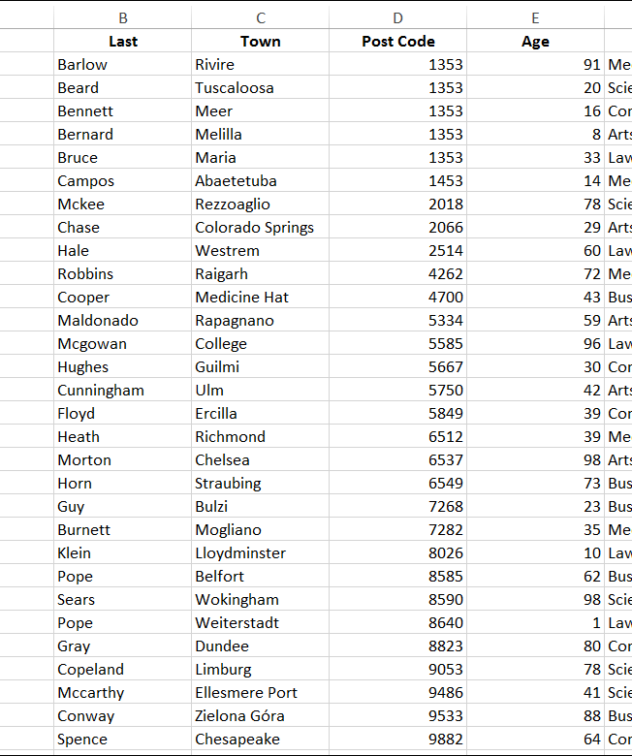
Sorting data
Let’s now sort the data by two columns – Post Code and Last (name).
Select all of the columns
Select Data > Sort
Sort by Post Code > Values > Smallest to Largest
Click Add Level
Sort by Last > Values > A to Z
Click OK
All of the students from Post Code 1353 appear first, and these students are sorted into alphabetical order by surname.

Slide 20
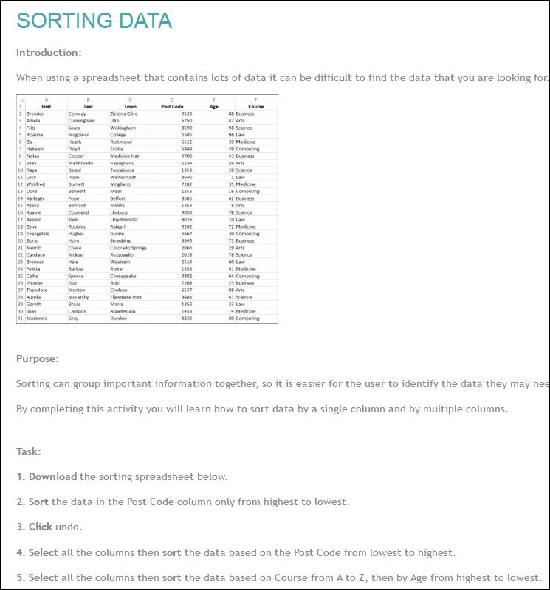
Activity: Sorting data
Complete the Sorting activity posted on elearn.

Slide 21
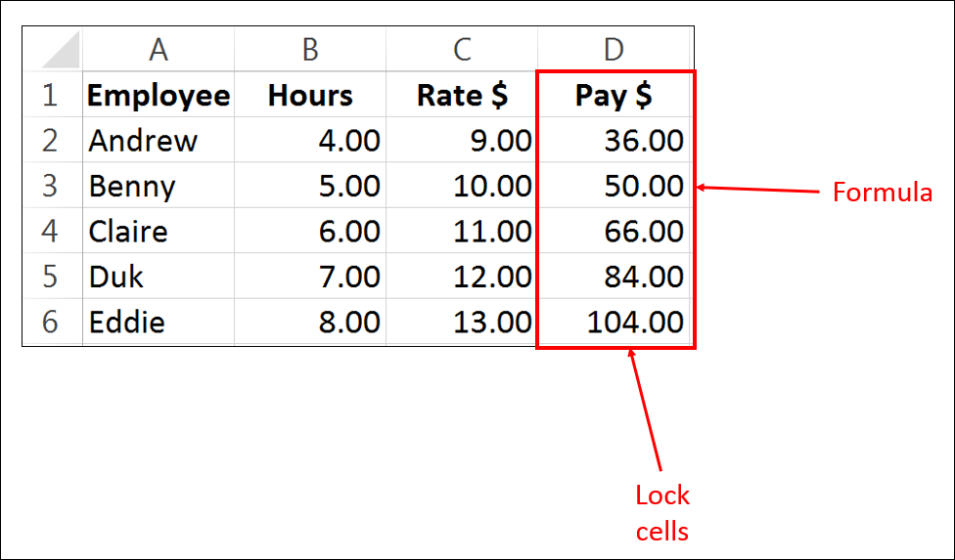
Cell protection
Cell protection involves locking cells, so a user is unable to access the cell and make changes to the contents of the cell.
Cell protection is mostly used to lock cells that contain a formula to stop the user accidently deleting the formula.

Slide 22
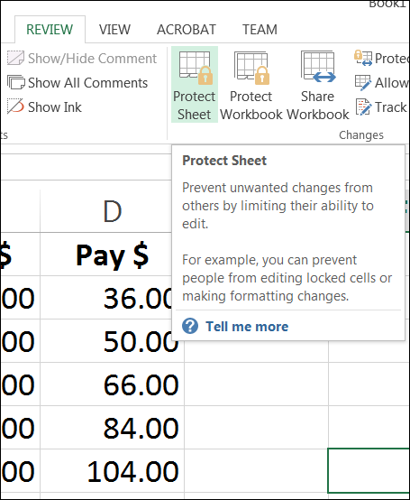
Cell protection
A user can still see the values stored in the cells, but they are unable to edit or delete the contents in each cell.
Cell protection can be turned on or off.
This is done using the Protect Sheet icon in the Review menu.
But there are a number of tricky steps that need to be completed first, before cell protection will work.

Slide 23
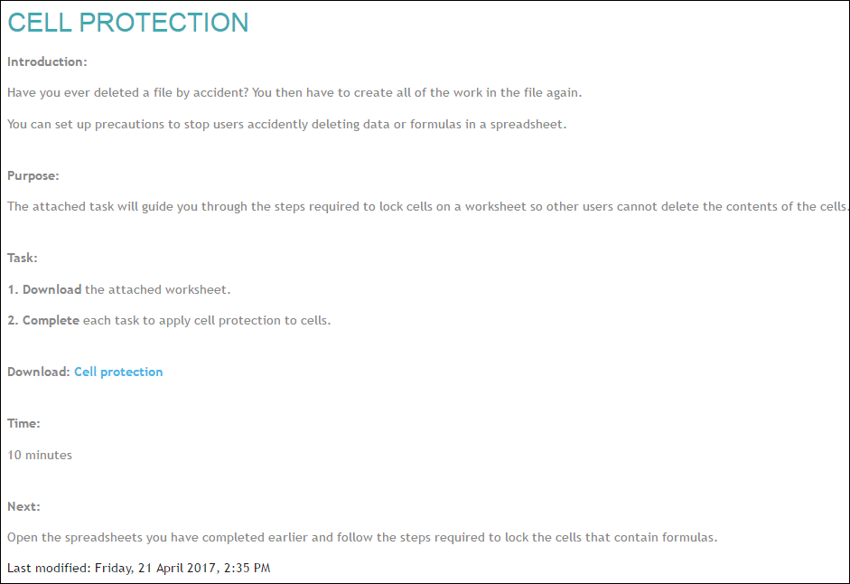
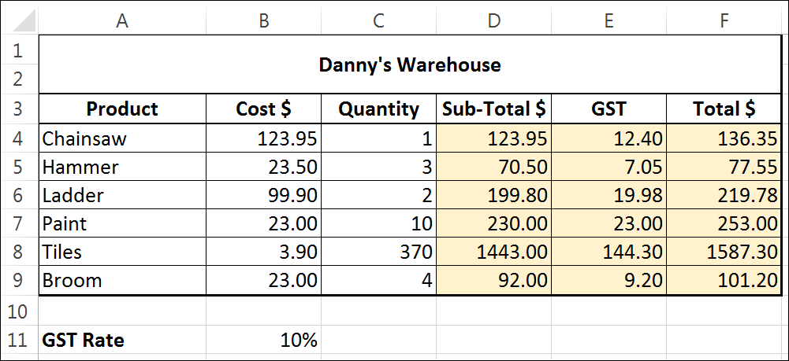
Activity: Cell protection
Let’s complete a tutorial that will go through all the steps required to lock and protect cells.
Go to elearn and complete the cell protection activity.

Slide 24

Write workbook notes
Complete workbook notes on page 4:
Absolute cell reference
Cell protection
Fill handle
Relative cell reference
Sorting data

